Slide 1
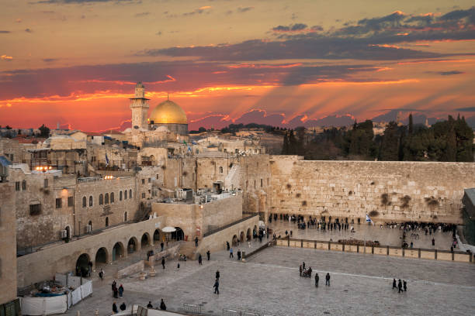
ISRAEL The Story of God’s People

Slide 2
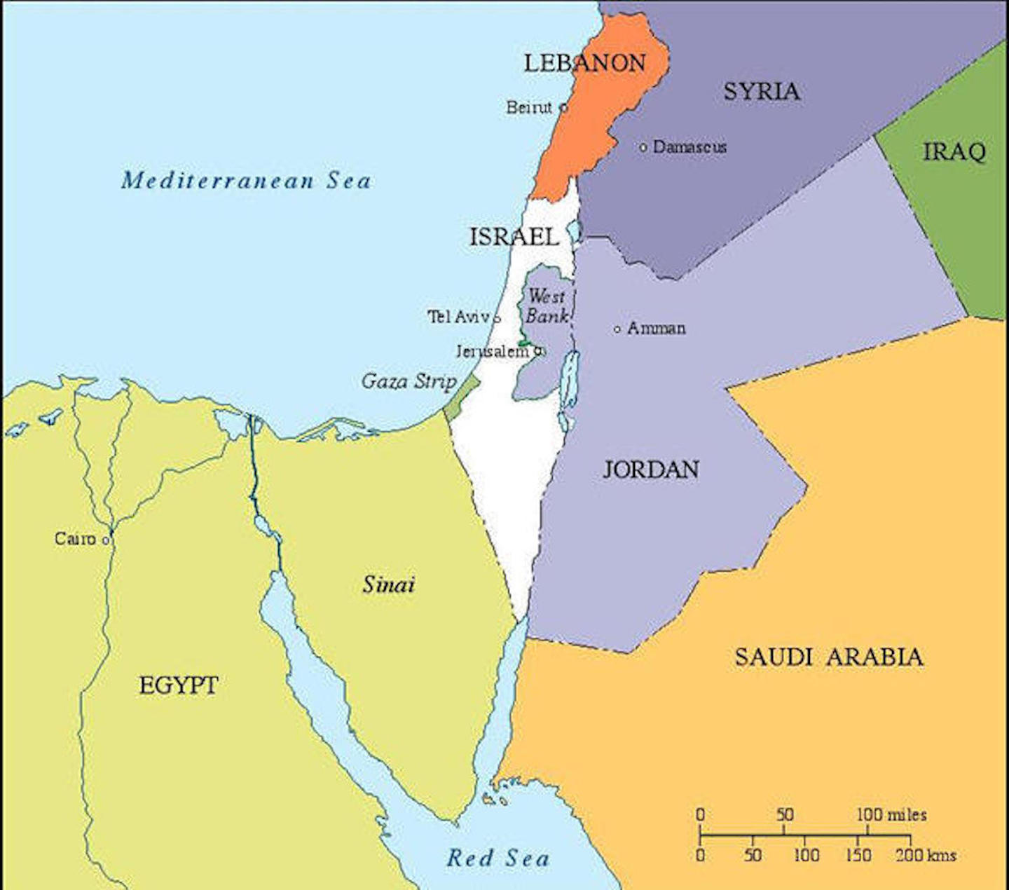

Slide 3
Genesis 22:18
“…and in your offspring shall all the nations of the earth be blessed, because you have obeyed my voice.”

Slide 4
ISRAEL The Story of God’s People

Slide 5
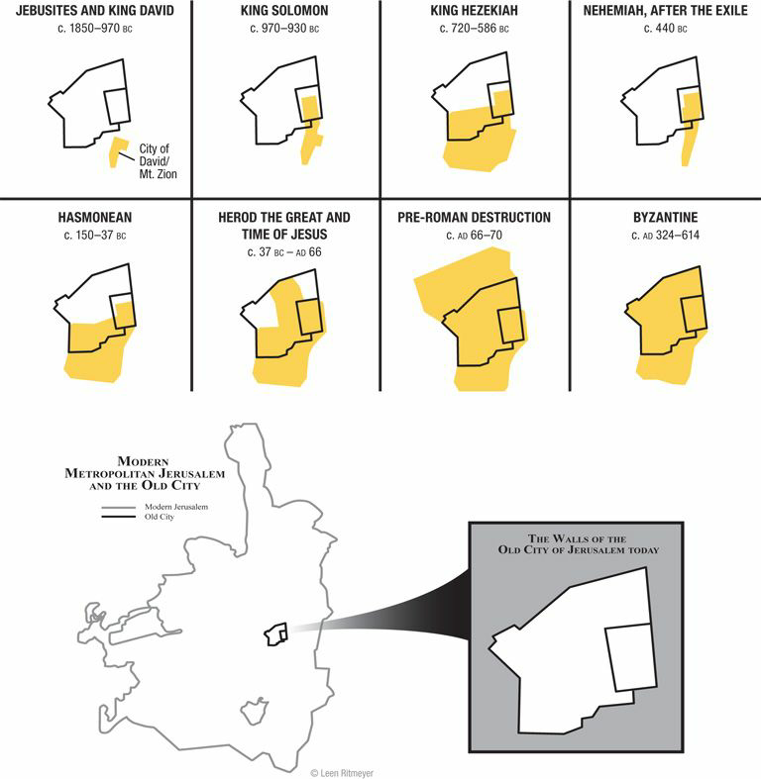

Slide 6
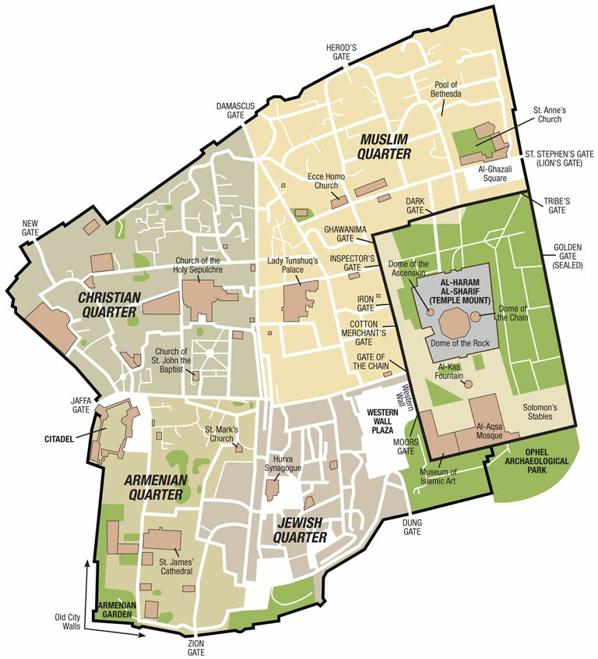

Slide 12
ISRAEL The Story of God’s People

Slide 13
אֱלֹהִ֑ים - elohim – “God”
יְהוָ֥ה - YHWH – “LORD”
תֵּ֣ל - tel - “mound” or “hill”
בַּיִת - baith/beth – “house”

Slide 14
איִשְׂרָאֵ֑ל - Israel
‎שָׁל֙וֹם - shalom - “peace”
‎יְרוּשָׁלִַ֗ם - Jerusalem
יְהוֹשֻׁ֥עַ - yeshua - Joshua/Jesus

Slide 15
ISRAEL The Story of God’s People

Slide 16
