Slide 1
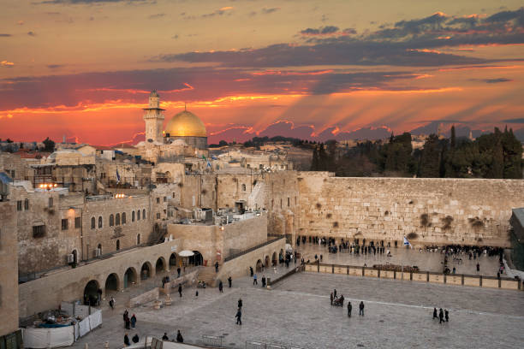
ISRAEL The Story of God’s People

Slide 6
Genesis 11:26-32
After Terah had lived 70 years, he became the father of Abram, Nahor, and Haran. This is the account of Terah’s family line. Terah became the father of Abram, Nahor and Haran. And Haran became the father of Lot. While his father Terah was still alive, Haran died in Ur of the Chaldeans, in the land of his birth. Abraham and Nahor both married.

Slide 7
The name of Abram’s wife was Sarai, and the name of Nahor’s wife was Milkah; she was the daughter of Haran, the father of both Milkah and Iskah. Now Sarai was childless because she was not able to conceive. Terah took his son Abram, his grandson Lot son of Haran, and his daughter-in-law Sarai, the wife of his son Abram, and together they set out from Ur of the Chaldeans to go to Canaan.

Slide 8
But when they came to Harran, they settled there. Terah lived 205 years, and he died in Harran.
Genesis 11:26-32

Slide 10
Genesis 12:1-7
The Lord had said to Abram, “Go from your country, your people and your father’s household to the land I will show you. I will make you into a great nation, and I will bless you; I will make your name great, and you will be a blessing. I will bless those who bless you, and whoever curses you I will curse; and all peoples on earth will be blessed through you.”

Slide 11
So Abram went, as the Lord had told him; and Lot went with him. Abram was seventy-five years old when he set out from Harran. He took his wife Sarai, his nephew Lot, all the possessions they had accumulated and the people they had acquired in Harran, and they set out for the land of Canaan, and they arrived there. Abram traveled through the land as far as the site of the great tree of Moreh at Shechem.

Slide 12
At that time the Canaanites were in the land. The Lord appeared to Abram and said, “To your offspring I will give this land.” So he built an altar there to the Lord, who had appeared to him.
Genesis 12:1-7

Slide 14
Genesis 14:21-23
The king of Sodom said to Abram, “Give me the people and keep the goods for yourself.” But Abram said to the king of Sodom, “With raised hand I have sworn an oath to the Lord, God Most High, Creator of heaven and earth, that I will accept nothing belonging to you, not even a thread or the strap of a sandal, so that you will never be able to say, ‘I made Abram rich.’

Slide 15
I will accept nothing but what my men have eaten and the share that belongs to the men who went with me.”
Genesis 14:21-23

Slide 16
Then Melchizedek king of Salem brought out bread and wine. He was priest of God Most High, and he blessed Abram saying, “Blessed be Abram by God Most High, Creator of heaven and earth. And praise be to God Most High, who delivered your enemies into your hand.” Then Abram gave him a tenth of everything.
Genesis 14:18-20

Slide 17
Genesis 15:1-14, 17-18
After this, the word of the Lord came to Abram in a vision: “Do not be afraid, Abram. I am your shield, your very great reward.” But Abram said, “Sovereign Lord, what can you give me since I remain childless and the one who will inherit my estate is Eliezer of Damascus?” And Abram said, “You have given me no children; so a servant in my household will be my heir.”

Slide 18
Then the word of the Lord came to him: “This man will not be your heir, but a son who is your own flesh and blood will be your heir.”
He took him outside and said, “Look up at the sky and count the stars – if indeed you can count them.” Then he said to him, “So shall your offspring be.” Abram believed the Lord, and he credited it to him as righteousness.

Slide 19
He also said to him, “I am the Lord, who brought you out of Ur of the Chaldeans to give you this land to take possession of it.” But Abram said, “Sovereign Lord, how can I know that I will gain possession of it?” So the Lord said to him, “Bring me a heifer (female cow), a goat and a ram, each three years old, along with a dove and a young pigeon.” Abram brought all these to him, cut them in two and arranged the halves opposite each

Slide 20
other; the birds, however, he did not cut in half. Then birds of prey came down on the carcasses, but Abram drove them away. As the sun was setting, Abram fell into a deep sleep, and a thick and dreadful darkness came over him. Then the Lord said to him, “Know for certain that for four hundred years your descendants will be strangers in a country not their own and they will be enslaved and mistreated there. But I will punish

Slide 21
the nation they serve as slaves, and afterward they will come out with great possessions. When the sun had set and darkness had fallen, a smoking firepot with a blazing torch appeared and passed between the pieces. On that day the Lord made a covenant with Abram and said, “To your descendants I give this land, from the Wadi (river) of Egypt to the great river, the Euphrates –
Genesis 15:1-14, 17-18

Slide 22
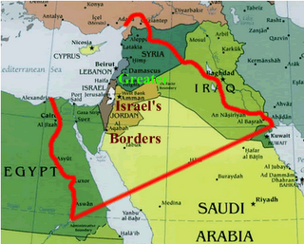

Slide 23
Those who have violated my covenant and have not fulfilled the terms of the covenant they made before me, I will treat like the calf they cut in two and then walked between its pieces.
Jeremiah 34:18

Slide 24
Jeremiah 31:35-37
This is what the Lord says, he who appoints the sun to shine by day, who decrees the moon and stars to shine by night, who stirs up the sea so that its waves roar – the Lord Almighty is his name: “Only if these decrees vanish from my sight,” declares the Lord, “will Israel ever cease being a nation before me.” This is what the Lord says: “Only if the heavens above can be measured and

Slide 25
the foundations of the earth below be searched out will I reject all the descendants of Israel because of all they have done,” declares the Lord.
Jeremiah 31:35-37

Slide 26
Genesis 16:6-12
“Your slave is in your hands,” Abram said. “Do with her whatever you think best.” Then Sarai mistreated Hagar; so she fled from her. The angel of the Lord found Hagar near a spring in the desert; it was the spring that is beside the road to Shur. And he said, “Hagar, slave of Sarai, where have you come from, and where are you going?”

Slide 27
“I’m running away from my mistress Sarai,” she answered. Then the angel of the Lord told her, “Go back to your mistress and submit to her.” The angel added, “I will increase your descendants so much that they will be too numerous to count.” The angel of the Lord also said to her: “You are now pregnant and you will give birth to a son. You shall name him Ishmael, for the Lord has heard of your misery. He will be a wild donkey of a man;

Slide 28
his hand will be against everyone and everyone’s hand against him, and he will live in hostility toward all his brothers.”
Genesis 16:6-12

Slide 29
Genesis 17:1-8
When Abram was ninety-nine years old, the Lord appeared to him and said, “I am God Almighty; walk before me faithfully and be blameless. Then I will make my covenant between me and you and will greatly increase your numbers.” Abram fell facedown, and God said to him, “As for me, this is my covenant with you: You will be the father of many nations. No longer will you be called Abram;

Slide 30
your name will be Abraham, for I have made you a father of many nations. I will make you very fruitful; I will make nations of you, and kings will come from you. I will establish my covenant as an everlasting covenant between me and you and your descendants after you for the generations to come, to be your God and the God of your descendants after you. The whole land of Canaan, where you now reside as a foreigner, I will give as an

Slide 31
everlasting possession to you and your descendants after you; and I will be their God.”
Genesis 17:1-8

Slide 36
Throughout Sodom and Gomorrah, brimstone is found embedded in the ground

Slide 37
Now the Lord was gracious to Sarah as he had said, and the Lord did for Sarah what he had promised. Sarah became pregnant and bore a son to Abraham in his old age, at the very time God had promised him. Abraham gave the name Isaac to the son Sarah bore him.
Genesis 21:1-3

Slide 38
Genesis 22:1-18
Some time later God tested Abraham. He said to him, “Abraham!” “Here I am,” he replied. Then God said, “Take your son, your only son, whom you love – Isaac – and go to the region of Moriah. Sacrifice him there as a burnt offering on a mountain I will show you.” Early the next morning Abraham got up and loaded his donkey. He took with him two of his servants and his son Isaac.

Slide 39
When he had cut enough wood for the burnt offering, he set out for the place God had told him about. On the third day Abraham looked up and saw the place in the distance. He said to his servants, “Stay here with the donkey while I and the boy go over there. We will worship and then we will come back to you.” Abraham took the wood for the burnt offering and placed it on his son Isaac, and he himself carried the fire and the

Slide 40
knife. As the two of them went on together, Isaac spoke up and said to his father Abraham, “Father?” “Yes, my son?” Abraham replied. “The fire and wood are here,” Isaac said, “but where is the lamb for the burnt offering?” Abraham answered, “God himself will provide the lamb for the burnt offering, my son.” And the two of them went on together. When they reached the place God had told him about, Abraham built an altar

Slide 41
there and arranged the wood on it. He bound his son Isaac and laid him on the altar, on top of the wood. Then he reached out his hand and took the knife to slay his son. But the angel of the Lord called out to him from heaven, “Abraham! Abraham!” “Here I am,” he replied. “Do not lay a hand on the boy,” he said. “Do not do anything to him. Now I know that your fear God, because you have not withheld from me your son, your only

Slide 42
son.” Abraham looked up and there in a thicket he saw a ram caught by its horns. He went over and took the ram and sacrificed it as a burnt offering instead of his son. So Abraham called that place The Lord Will Provide. And to this day it is said, “On the mountain of the Lord it will be provided.”
Genesis 22:1-18

Slide 43
Then Solomon began to build the temple of the Lord in Jerusalem on Mount Moriah, where the Lord had appeared to his father David.”
2 Chronicles 3:1

Slide 45
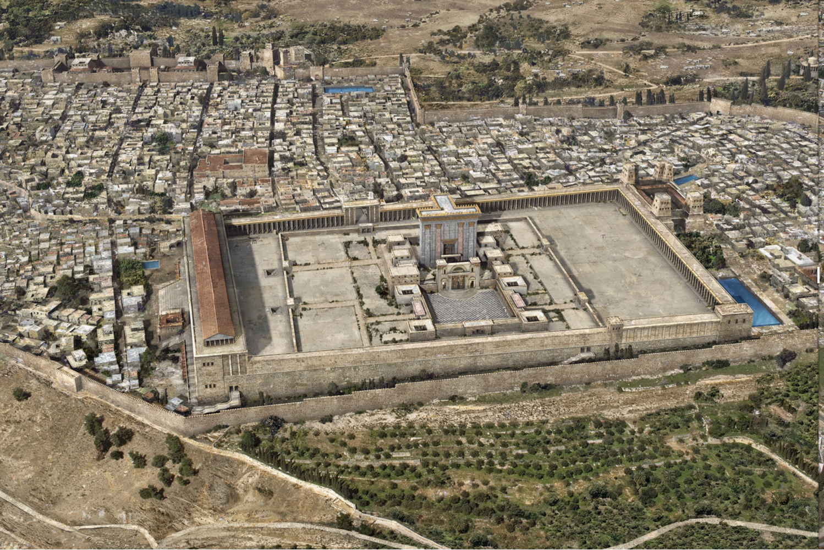

Slide 48
Then the Lord said to him, “Know for certain that for four hundred years your descendants will be strangers in a country not their own and they they will be enslaved and mistreated there. But I will punish the nation they serve as slaves, and afterward they will come out with great possessions.”
Genesis 15:13-14

