Slide 1
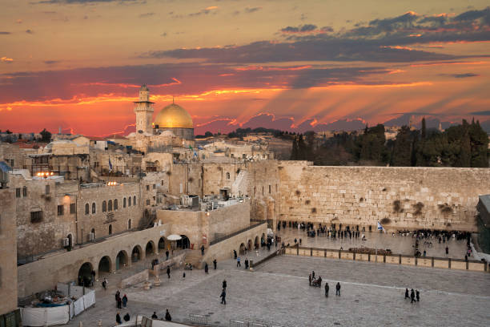
ISRAEL The Story of God’s People

Slide 3
Then the LORD said to him, “Know for certain that for four hundred years your descendants will be strangers in a country not their own and that they will be enslaved and mistreated there.”
Genesis 15:13 (NIV)

Slide 4
Exodus 1:1-11 (NIV)
These are the names of the sons of Israel who went to Egypt with Jacob, each with his family: Reuben, Simeon, Levi and Judah; Issachar, Zebulun and Benjamin; Dan and Naphtali; Gad and Asher. The descendants of Jacob numbered seventy in all; Joseph was already in Egypt. Now Joseph and all his brothers and all that generation died, but the Israelites were exceedingly fruitful;

Slide 5
they multiplied greatly, increased in numbers and became so numerous that the land was filled with them. Then a new king, to whom Joseph meant nothing, came to power in Egypt. “Look,” he said to his people, “the Israelites have become far too numerous for us. Come, we must deal shrewdly with them or they will become even more numerous and, if war breaks out, will join our enemies, fight against us and leave the country.”

Slide 6
So they put slave masters over them to oppress them with forced labor, and they built Pithom and Rameses as store cities for Pharaoh.
Exodus 1:1-11 (NIV)

Slide 8
Exodus 2:1-10 (NIV)
Now a man of the tribe of Levi married a Levite woman, and she became pregnant and gave birth to a son. When she saw that he was a fine child, she hid him for three months. But when she could hide him no longer, she got a papyrus basket for him and coated it with tar and pitch. Then she placed the child in it and put it among the reeds along the bank of the Nile. His sister stood

Slide 9
at a distance to see what would happen to him.
Then Pharaoh’s daughter went down to the Nile to bathe, and her attendants were walking along the riverbank. She saw the basket among the reeds and sent her female slave to get it. She opened it and saw the baby. He was crying, and she felt sorry for him. “This is one of the Hebrew babies,” she said. Then his sister asked Pharaoh’s daughter, “Shall I go and get one of the Hebrew women to

Slide 10
nurse the baby for you?” “Yes, go,” she answered. So the girl went and got the baby’s mother. Pharaoh’s daughter said to her, “Take this baby and nurse him for me, and I will pay you.” So the woman took the baby and nursed him. When the child grew older, she took him to Pharaoh’s daughter and he became her son. She named him Moses, saying, “I drew him out of the water.”
Exodus 2:1-10 (NIV)

Slide 12
During that long period, the king of Egypt died. The Israelites groaned in their slavery and cried out, and their cry for help because of their slavery went up to God.
Exodus 2:23 (NIV)

Slide 14
Moses said to God, “Suppose I go to the Israelites and say to them, ‘The God of your fathers has sent me to you,’ and they ask me, ‘What is his name?’ Then what shall I tell them?” God said to Moses, “I AM WHO I AM. This is what you are to say to the Israelites: ‘I AM has sent me to you.’”
Exodus 3:13-14 (NIV)

Slide 15
“Very truly I tell you,” Jesus answered, “before Abraham was born, I am!”
John 8:58 (NIV)

Slide 17
So Moses said, “This is what the LORD says: ‘About midnight I will go throughout Egypt. Every firstborn son in Egypt will die, from the firstborn son of Pharaoh, who sits on the throne, to the firstborn son of the female slave, who is at her hand mill, and all the firstborn of the cattle as well. There will be loud wailing throughout Egypt—worse than there has ever been or ever will be again.
Exodus 11:4-6 (NIV)

Slide 18
Exodus 12:12-14 (NIV)
“On that same night I will pass through Egypt and strike down every firstborn of both people and animals, and I will bring judgment on all the gods of Egypt. I am the LORD. The blood will be a sign for you on the houses where you are, and when I see the blood, I will pass over you. No destructive plague will touch you when I strike Egypt. “This is a day you are to commemorate;

Slide 19
for the generations to come you shall celebrate it as a festival to the LORD — a lasting ordinance.
Exodus 12:12-14 (NIV)

Slide 20
“Do not think that I have come to abolish the Law or the Prophets; I have not come to abolish them but to fulfill them.”
Matthew 5:17 (NIV)

Slide 22
Exodus 12:33-36 (NIV)
The Egyptians urged the people to hurry and leave the country. “For otherwise,” they said, “we will all die!” So the people took their dough before the yeast was added, and carried it on their shoulders in kneading bowls wrapped in clothing. The Israelites did as Moses instructed and asked the Egyptians for articles of silver and gold and for clothing. The LORD had made the Egyptians

Slide 23
favorably disposed toward the people, and they gave them what they asked for; so they plundered the Egyptians.
Exodus 12:33-36 (NIV)

Slide 25
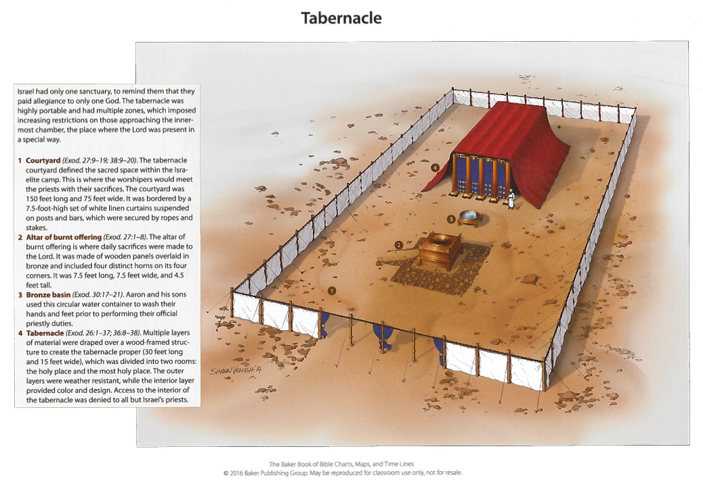

Slide 28
Jeremiah 3:16-17 (NIV)
In those days, when your numbers have increased greatly in the land,” declares the LORD, “people will no longer say, ‘The ark of the covenant of the LORD.’ It will never enter their minds or be remembered; it will not be missed, nor will another one be made. At that time they will call Jerusalem The Throne of the LORD, and all nations will gather in Jerusalem to honor the

Slide 29
name of the LORD. No longer will they follow the stubbornness of their evil hearts.
Jeremiah 3:16-17 (NIV)

Slide 30
When the LORD heard what you said, he was angry and solemnly swore: “No one from this evil generation shall see the good land I swore to give your ancestors...”
Deuteronomy 1:34-35 (NIV)

Slide 31
Deuteronomy 34:1,4-8 (NIV)
Then Moses climbed Mount Nebo from the plains of Moab to the top of Pisgah, across from Jericho. There the Lord showed him the whole land — Then the LORD said to him, “This is the land I promised on oath to Abraham, Isaac and Jacob when I said, ‘I will give it to your descendants.’ I have let you see it with your eyes, but you will not cross over into it.” And Moses the

Slide 32
servant of the LORD died there in Moab, as the LORD had said. He buried him in Moab, in the valley opposite Beth Peor, but to this day no one knows where his grave is. Moses was a hundred and twenty years old when he died, yet his eyes were not weak nor his strength gone. The Israelites grieved for Moses in the plains of Moab thirty days, until the time of weeping and mourning was over.
Deuteronomy 34:1,4-8 (NIV)

Slide 33
Since then, no prophet has risen in Israel like Moses, whom the LORD knew face to face…
Deuteronomy 34:10 (NIV)

Slide 34
This is because both of you broke faith with me in the presence of the Israelites at the waters of Meribah Kadesh in the Desert of Zin and because you did not uphold my holiness among the Israelites. Therefore, you will see the land only from a distance; you will not enter the land I am giving to the people of Israel.”
Deuteronomy 32:51-52 (NIV)

Slide 35
Joshua 1:1-5 (NIV)
After the death of Moses the servant of the LORD, the LORD said to Joshua son of Nun, Moses’ aide: “Moses my servant is dead. Now then, you and all these people, get ready to cross the Jordan River into the land I am about to give to them — to the Israelites. I will give you every place where you set your foot, as I promised Moses. Your territory will extend from the desert to Lebanon,

Slide 36
and from the great river, the Euphrates — all the Hittite country — to the Mediterranean Sea in the west. No one will be able to stand against you all the days of your life. As I was with Moses, so I will be with you; I will never leave you nor forsake you.
Joshua 1:1-5 (NIV)

Slide 37
Before the spies lay down for the night, she went up on the roof and said to them, “I know that the LORD has given you this land and that a great fear of you has fallen on us, so that all who live in this country are melting in fear because of you.
Joshua 2:8-9 (NIV)

Slide 38
Salmon the father of Boaz, whose mother was Rahab, Boaz the father of Obed, whose mother was Ruth, Obed the father of Jesse, and Jesse the father of King David. David was the father of Solomon, whose mother had been Uriah’s wife…¹⁶and Jacob the father of Joseph, the husband of Mary, and Mary was the mother of Jesus who is called the Messiah.
Matthew 1:5-6,16 (NIV)

Slide 39
Joshua 3:7-13 (NIV)
And the LORD said to Joshua, “Today I will begin to exalt you in the eyes of all Israel, so they may know that I am with you as I was with Moses. Tell the priests who carry the ark of the covenant: ‘When you reach the edge of the Jordan’s waters, go and stand in the river.’” Joshua said to the Israelites, “Come here and listen to the words of the LORD your God. This is how you will know

Slide 40
that the living God is among you and that he will certainly drive out before you the Canaanites, Hittites, Hivites, Perizzites, Girgashites, Amorites and Jebusites. See, the ark of the covenant of the LORD of all the earth will go into the Jordan ahead of you. Now then, choose twelve men from the tribes of Israel, one from each tribe. And as soon as the priests who carry the ark of the LORD — the LORD of all the earth — set foot in the Jordan,

Slide 41
its waters flowing downstream will be cut off and stand up in a heap.”
Joshua 3:7-13 (NIV)

Slide 44
When the trumpets sounded, the army shouted, and at the sound of the trumpet, when the men gave a loud shout, the wall collapsed; so everyone charged straight in, and they took the city. Then they burned the whole city and everything in it, but they put the silver and gold and the articles of bronze and iron into the treasury of the LORD’s house.
Joshua 6:20,24 (NIV)

Slide 45
So the LORD gave Israel all the land he had sworn to give their ancestors, and they took possession of it and settled there. The LORD gave them rest on every side, just as he had sworn to their ancestors. Not one of their enemies withstood them; the LORD gave all their enemies into their hands. Not one of all the LORD’s good promises to Israel failed; every one was fulfilled.
Joshua 21:43-45 (NIV)

Slide 46
Here is a list of the kings of the land that Joshua and the Israelites conquered on the west side of the Jordan…
the king of Jericho,
the king of Ai (near Bethel),
the king of Jerusalem,
the king of Hebron...
²⁴ the king of Tirzah, thirty-one kings in all.
Joshua 12:7,9-10,24 (NIV)

Slide 47
The men of Judah attacked Jerusalem also and took it. They put the city to the sword and set it on fire.
Judges 1:8 (NIV)

