Slide 1
Hot Button Issues
Calvinism vs. arminianism

Slide 2
Outline
Introduction
The Case for Calvinism
The Case for Arminianism
Evaluation

Slide 3
The Case for Calvinism
TULIP
Total Depravity
Unconditional Election
Limited Atonement
Irresistible Grace
Perseverance of the Saints

Slide 4
The Case for Calvinism: Total Depravity
Romans 3:10-12
as it is written: "None is righteous, no, not one; ¹¹ no one understands; no one seeks for God. ¹² All have turned aside; together they have become worthless; no one does good, not even one."

Slide 5
The Case for Calvinism: Total Depravity
Ephesians 2:1
And you were dead in the trespasses and sins…

Slide 6
The Case for Calvinism: Unconditional Election
Eph. 1:4-6
…he chose us in him before the foundation of the world, that we should be holy and blameless before him. In love ⁵ he predestined us for adoption to himself as sons through Jesus Christ, according to the purpose of his will, ⁶ to the praise of his glorious grace, with which he has blessed us in the Beloved.

Slide 7
The Case for Calvinism: Unconditional Election
Eph. 1:4-6
…he chose us in him before the foundation of the world, that we should be holy and blameless before him. In love ⁵ he predestined us for adoption to himself as sons through Jesus Christ, according to the purpose of his will, ⁶ to the praise of his glorious grace, with which he has blessed us in the Beloved.

Slide 8
The Case for Calvinism: Unconditional Election
Rom. 8:29-30
For those whom he foreknew he also predestined to be conformed to the image of his Son, in order that he might be the firstborn among many brothers. ³⁰ And those whom he predestined he also called, and those whom he called he also justified, and those whom he justified he also glorified.

Slide 9
The Case for Calvinism: Unconditional Election
Rom. 9:18-23
So then he has mercy on whomever he wills, and he hardens whomever he wills. ¹⁹ You will say to me then, "Why does he still find fault? For who can resist his will?" ²⁰ But who are you, O man, to answer back to God? Will what is molded say to its molder, "Why have you made me like this?" ²¹ Has the potter no right over the clay, to make out of the same lump one vessel for honorable use and another for dishonorable use? ²² What if God, desiring to show his wrath and to make known his power, has endured with much patience vessels of wrath prepared for destruction, ²³ in order to make known the riches of his glory for vessels of mercy, which he has prepared beforehand for glory…

Slide 10
The Case for Calvinism: Limited Atonement
John 10:11, 14-15
I am the good shepherd. The good shepherd lays down his life for the sheep….¹⁴ I am the good shepherd. I know my own and my own know me, ¹⁵ just as the Father knows me and I know the Father; and I lay down my life for the sheep.

Slide 11
The Case for Calvinism: Limited Atonement
Matthew 26:28
for this is my blood of the covenant, which is poured out for many for the forgiveness of sins.

Slide 12
The Case for Calvinism: Irresistible Grace
John 6:44,65
⁴⁴ No one can come to me unless the Father who sent me draws him…. ⁶⁵ And he said, "This is why I told you that no one can come to me unless it is granted him by the Father."

Slide 13
The Case for Calvinism: Irresistible Grace
Philippians 1:29
For it has been granted to you that for the sake of Christ you should not only believe in him but also suffer for his sake,
Eph. 2:8
For by grace you have been saved through faith. And this is not your own doing; it is the gift of God,

Slide 14
The Case for Calvinism: Perseverance of the Saints
Mk. 13:13 ESV ¹³ And you will be hated by all for my name's sake. But the one who endures to the end will be saved.
Heb. 3:14 ESV ¹⁴ For we have come to share in Christ, if indeed we hold our original confidence firm to the end.

Slide 15
The Case for Calvinism: Perseverance of the Saints
1 Jn. 2:19 ESV ¹⁹ They went out from us, but they were not of us; for if they had been of us, they would have continued with us. But they went out, that it might become plain that they all are not of us.
1 Cor. 1:7-8 ESV ⁷ so that you are not lacking in any gift, as you wait for the revealing of our Lord Jesus Christ, ⁸ who will sustain you to the end, guiltless in the day of our Lord Jesus Christ.

Slide 16
The Case for Calvinism
Questions so far?

Slide 17
The Case for Arminianism
There is a difference between pop-Arminianism and classical Arminianism.

Slide 18
The Case for Arminianism
Calvinism | Arminianism
Total Depravity | Total Depravity
Unconditional Election | Election based on foreknowledge
Limited Atonement | Unlimited Atonement
Irresistible Grace | Prevenient Grace
Perseverance of the Saints | Difference of opinion

Slide 19
The Case for Arminianism: Total Depravity
This is a point of agreement between Calvinists and Arminians.
Those who deny Total Depravity are not Calvinists or Arminians—they are called Pelagians.
Pelagianism was condemned as a heresy at the Council of Ephesus in 431 AD. This is often called “Arminianism” at a popular level.

Slide 20
The Case for Arminianism: Election based on foreknowledge
Rom. 8:29-30 ESV ²⁹ For those whom he foreknew he also predestined to be conformed to the image of his Son, in order that he might be the firstborn among many brothers. ³⁰ And those whom he predestined he also called, and those whom he called he also justified, and those whom he justified he also glorified.

Slide 21
The Case for Arminianism: Election based on foreknowledge
Often, Arminians view election as being corporate.
1 Pet. 2:9 ESV 9 But you are a chosen race, a royal priesthood, a holy nation, a people for his own possession, that you may proclaim the excellencies of him who called you out of darkness into his marvelous light.

Slide 22
The Case for Arminianism: Election based on foreknowledge
Often, Arminians view election as being corporate.
Eph. 1:3-6 ESV ³ Blessed be the God and Father of our Lord Jesus Christ, who has blessed us in Christ with every spiritual blessing in the heavenly places, ⁴ even as he chose us in him before the foundation of the world, that we should be holy and blameless before him. In love ⁵ he predestined us for adoption to himself as sons through Jesus Christ, according to the purpose of his will, ⁶ to the praise of his glorious grace, with which he has blessed us in the Beloved.

Slide 23
The Case for Arminianism: Unlimited Atonement
1 Jn. 2:2 ESV ² He is the propitiation for our sins, and not for ours only but also for the sins of the whole world.
Jn. 3:16 ESV ¹⁶ "For God so loved the world, that he gave his only Son, that whoever believes in him should not perish but have eternal life.
Heb. 2:9 ESV ⁹ But we see him who for a little while was made lower than the angels, namely Jesus, crowned with glory and honor because of the suffering of death, so that by the grace of God he might taste death for everyone.

Slide 24
The Case for Arminianism: Unlimited Atonement
2 Cor. 5:14-15 For the love of Christ controls us, because we have concluded this: that one has died for all, therefore all have died; ¹⁵ and he died for all, that those who live might no longer live for themselves but for him who for their sake died and was raised.
2 Pet. 2:1 But false prophets also arose among the people, just as there will be false teachers among you, who will secretly bring in destructive heresies, even denying the Master who bought them, bringing upon themselves swift destruction.

Slide 25
The Case for Arminianism: Prevenient Grace
1 Tim. 2:3-4 ESV ³ This is good, and it is pleasing in the sight of God our Savior, ⁴ who desires all people to be saved and to come to the knowledge of the truth.
2 Pet. 3:9 ESV ⁹ The Lord is not slow to fulfill his promise as some count slowness, but is patient toward you, not wishing that any should perish, but that all should reach repentance.

Slide 26
The Case for Arminianism: Prevenient Grace
Jn. 1:9 ESV ⁹ The true light, which gives light to everyone, was coming into the world.
Jn. 16:7-11 ESV ⁷ Nevertheless, I tell you the truth: it is to your advantage that I go away, for if I do not go away, the Helper will not come to you. But if I go, I will send him to you. ⁸ And when he comes, he will convict the world concerning sin and righteousness and judgment: ⁹ concerning sin, because they do not believe in me; ¹⁰ concerning righteousness, because I go to the Father, and you will see me no longer; ¹¹ concerning judgment, because the ruler of this world is judged.

Slide 27
The Case for Arminianism: Perseverance of the Saints?
Arminians are divided on the question of whether you can lose your salvation or not.
At Temecula Hills, we teach that you cannot lose your salvation, and this seems well supported by Scripture.
Jn. 10:28-29 ESV ²⁸ I give them eternal life, and they will never perish, and no one will snatch them out of my hand. ²⁹ My Father, who has given them to me, is greater than all, and no one is able to snatch them out of the Father's hand.

Slide 28
Evaluation
Key Difference: How do we get saved?
Calvinists: God produces in us the decisive desire for Christ.
Arminians: We cease resisting, and God produces in us the desire for Christ.
Pelagians: We produce the decisive desire for Christ in ourselves.

Slide 29
Evaluation

Slide 30
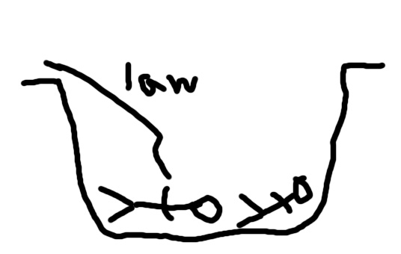
Evaluation
Pelagianism
Semi-Pelagianism

Slide 31
Evaluation

Slide 32
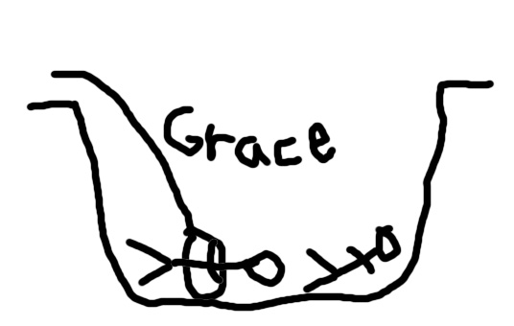
Evaluation
Calvinism

Slide 33
Evaluation

Slide 34
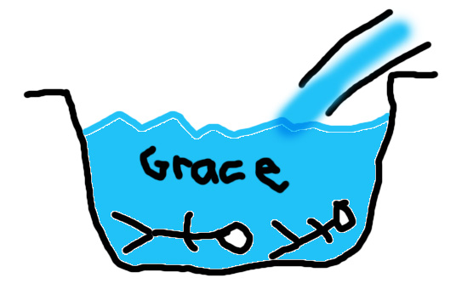
Evaluation
Arminianism

Slide 35
Evaluation: Problems for Arminianism
Does not take God’s choice seriously enough
The idea of losing genuine salvation is not biblical
Corporate election does not tell the whole story

Slide 36
Evaluation: Problems for Arminianism
Rom. 9:6 ESV ⁶ But it is not as though the word of God has failed. For not all who are descended from Israel belong to Israel,
Rom. 9:24-25 ESV ²⁴ even us whom he has called, not from the Jews only but also from the Gentiles? ²⁵ As indeed he says in Hosea, "Those who were not my people I will call 'my people,' and her who was not beloved I will call 'beloved.'"
Eph. 1:4-6 ESV ⁴ even as he chose us in him before the foundation of the world, that we should be holy and blameless before him. In love ⁵ he predestined us for adoption to himself as sons through Jesus Christ, according to the purpose of his will, ⁶ to the praise of his glorious grace, with which he has blessed us in the Beloved.
Acts 13:48 ESV as many as were appointed to eternal life believed.

Slide 37
Evaluation: Problems for Calvinism
Limited atonement
Does not take God’s foreknowledge seriously enough
Is faith really a gift?

Slide 38
Evaluation: Problems for Calvinism
Does not take God’s foreknowledge seriously enough
1 Pet. 1:1 NIV who have been chosen according to the foreknowledge of God the Father, through the sanctifying work of the Spirit, to be obedient to Jesus Christ and sprinkled with his blood: Grace and peace be yours in abundance.
Rom. 8:29-30 ESV ²⁹ For those whom he foreknew he also predestined to be conformed to the image of his Son, in order that he might be the firstborn among many brothers. ³⁰ And those whom he predestined he also called, and those whom he called he also justified, and those whom he justified he also glorified.

Slide 39
Evaluation: Problems for Calvinism
Is faith really a gift?
Eph. 2:8 ESV ⁸ For by grace you have been saved through faith. And this is not your own doing; it is the gift of God,
Phil. 1:29 ESV ²⁹ For it has been granted to you that for the sake of Christ you should not only believe in him but also suffer for his sake,

Slide 40
Evaluation: Another Option: Molinism
1. Natural knowledge – knowledge of all possibilities
2. Middle-knowledge – knowledge of how free creatures would act in any given situation
GOD’S DECISION TO CREATE THE WORLD
3. Free knowledge – knowledge of all actualities

Slide 41
Evaluation: Another Option: Molinism
Acts 17:26-27 ESV ²⁶ And he made from one man every nation of mankind to live on all the face of the earth, having determined allotted periods and the boundaries of their dwelling place, ²⁷ that they should seek God, and perhaps feel their way toward him and find him.

Slide 42
Evaluation: Another Option: Molinism
Using middle-knowledge, we can affirm:
Unconditional election
Election based on real foreknowledge

Slide 43
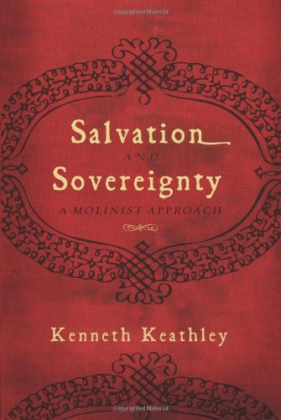
Evaluation
Recommendations for future study:
Molinism: Salvation and Sovereignty by Kenneth Keathley
Calvinism: For Calvinism by Michael Horton
Arminianism: Arminian Theology: Myths and Reality by Roger Olson

