Slide 1
Hot Button Issues
The Bible and LGBTQ Issues

Slide 2
Outline
Overview of biblical sexuality
Biblical Principles re: Homosexuality
Responding to Specific Passages
Psychological and Transgender Research

Slide 3
Biblical Sexuality
Gen. 2:18-25 ESV
Then the LORD God said, "It is not good that the man should be alone; I will make him a helper fit for him." ¹⁹ Now out of the ground the LORD God had formed every beast of the field and every bird of the heavens and brought them to the man to see what he would call them. And whatever the man called every living creature, that was its name. ²⁰ The man gave names to all livestock and to the birds of the heavens and to every beast of the field. But for Adam there was not found a helper fit for him. ²¹ So the LORD God caused a deep sleep to fall upon the man, and while he slept took one of his ribs and closed up its place with flesh. ²² And the rib that the LORD God had taken from the man he made into a woman and brought her to the man. ²³ Then the man said, "This at last is bone of my bones and flesh of my flesh; she shall be called Woman, because she was taken out of Man." ²⁴ Therefore a man shall leave his father and his mother and hold fast to his wife, and they shall become one flesh. ²⁵ And the man and his wife were both naked and were not ashamed.

Slide 4
Biblical Sexuality
Matt. 19:3-6 ESV
And Pharisees came up to him and tested him by asking, "Is it lawful to divorce one's wife for any cause?" ⁴ He answered, "Have you not read that he who created them from the beginning made them male and female, ⁵ and said, 'Therefore a man shall leave his father and his mother and hold fast to his wife, and the two shall become one flesh'? ⁶ So they are no longer two but one flesh. What therefore God has joined together, let not man separate."

Slide 5
Biblical Principles Regarding Homosexuality
The Bible does not condemn same-sex attraction or temptation—the Bible condemns homosexual behavior and lust.

Slide 6
Biblical Principles Regarding Homosexuality
The Bible does not condemn same-sex attraction or temptation—the Bible condemns homosexual behavior and lust.
Having a disposition or proclivity does not justify expressing that disposition or proclivity.

Slide 7
Biblical Principles Regarding Homosexuality
The Bible does not condemn same-sex attraction or temptation—the Bible condemns homosexual behavior and lust.
Having a disposition or proclivity does not justify expressing that disposition or proclivity.
We all have a choice to either be mastered by Jesus or mastered by sin.

Slide 8
Biblical Principles Regarding Homosexuality
The Bible does not condemn same-sex attraction or temptation—the Bible condemns homosexual behavior and lust.
Having a disposition or proclivity does not justify expressing that disposition or proclivity.
We all have a choice to either be mastered by Jesus or mastered by sin.
We should respond to those who struggle with homosexuality with love and truth.

Slide 9
Specific Passages Genesis 19

Slide 10
Specific Passages Genesis 19
Ezek. 16:49 ESV ⁴⁹ Behold, this was the guilt of your sister Sodom: she and her daughters had pride, excess of food, and prosperous ease, but did not aid the poor and needy.

Slide 11
Specific Passages Genesis 19
Ezek. 16:47-50 ESV 47 Not only did you walk in their ways and do according to their abominations; within a very little time you were more corrupt than they in all your ways. 48 As I live, declares the Lord GOD, your sister Sodom and her daughters have not done as you and your daughters have done. 49 Behold, this was the guilt of your sister Sodom: she and her daughters had pride, excess of food, and prosperous ease, but did not aid the poor and needy. 50 They were haughty and did an abomination before me. So I removed them, when I saw it.

Slide 12
Specific Passages Genesis 19
Jude 1:7 ESV just as Sodom and Gomorrah and the surrounding cities, which likewise indulged in sexual immorality and pursued unnatural desire, serve as an example by undergoing a punishment of eternal fire.

Slide 13
Specific Passages Leviticus 18:22, 20:13
Lev. 18:22 ESV You shall not lie with a male as with a woman; it is an abomination.
Lev. 20:13 ESV If a man lies with a male as with a woman, both of them have committed an abomination; they shall surely be put to death; their blood is upon them.

Slide 14
Specific Passages Romans 1
Rom. 1:24-28
Therefore God gave them up in the lusts of their hearts to impurity, to the dishonoring of their bodies among themselves, ²⁵ because they exchanged the truth about God for a lie and worshiped and served the creature rather than the Creator, who is blessed forever! Amen. ²⁶ For this reason God gave them up to dishonorable passions. For their women exchanged natural relations for those that are contrary to nature; ²⁷ and the men likewise gave up natural relations with women and were consumed with passion for one another, men committing shameless acts with men and receiving in themselves the due penalty for their error. ²⁸ And since they did not see fit to acknowledge God, God gave them up to a debased mind to do what ought not to be done.

Slide 15
Specific Passages 1 Corinthians 6:9-11
⁹ Or do you not know that the unrighteous will not inherit the kingdom of God? Do not be deceived: neither the sexually immoral, nor idolaters, nor adulterers, nor men who practice homosexuality, ¹⁰ nor thieves, nor the greedy, nor drunkards, nor revilers, nor swindlers will inherit the kingdom of God. ¹¹ And such were some of you. But you were washed, you were sanctified, you were justified in the name of the Lord Jesus Christ and by the Spirit of our God.

Slide 16
Specific Passages 1 Corinthians 6:9-11
arsenkoite
arsen - man
koite - bed
Leviticus 20:13 hos an koimēthē meta arsenos koitēn gynaikos (“whoever shall lie with a male as with a woman”)

Slide 17
Specific Passages 1 Corinthians 6:9-11
⁹ Or do you not know that the unrighteous will not inherit the kingdom of God? Do not be deceived: neither the sexually immoral, nor idolaters, nor adulterers, nor men who practice homosexuality, ¹⁰ nor thieves, nor the greedy, nor drunkards, nor revilers, nor swindlers will inherit the kingdom of God. ¹¹ And such were some of you. But you were washed, you were sanctified, you were justified in the name of the Lord Jesus Christ and by the Spirit of our God.

Slide 19
Hot Button Issues
The Bible and LGBTQ Issues

Slide 20
LGBTQ:
The “Science”
Jeff Conner, M.D.

Slide 21
Dangerous Conversation

Slide 22
Overview
Causation controversy
Conversion therapy
Pederasty/Pedophilia corollaries
Transgenderism
A Christian response

Slide 23
The Christian worldview vs the World
Ephesians 2:1-10

Slide 24
Is life about serving God or about fulfilling our own desires?

Slide 25
Causation Controversy
What “causes” homosexuality?
American Psychiatric Association removed homosexuality as a pathologic diagnosis in 1973
Not considered a valid question now
It’s natural and “normal”
The science
Genetic vs. hereditable influence
Fetal androgen exposure
Younger of multiple brothers

Slide 26
If behavior is genetically and naturally influenced, is it automatically moral?
It’s easy to forget we live in a fallen world.

Slide 27
SSA- Same sex attraction vs Homosexual behavior
Is being sexually attracted to the opposite sex a sin?

Slide 28
Conversion Therapy
Discredited as harmful
Outdated abusive practices used to impugn modern techniques
Reparative therapy
Joseph Nicolosi, Sr.
Reintegrative therapy
Joseph Nicolosi, Jr.
Documentary: “Free to Love”
Change is possible but not assured

Slide 29
Christian organizations
Exodus International
Now defunct
Last leader compromised Christian message
Restored Hope Network
Living Out

Slide 30
Risks of Homosexuality
Life expectancy form gay men 20 years less than average population
Significant increased risk of infectious diseases and some cancers
HIV
Mental health
Acceptance by society has not decreased rate of MH issues
Promiscuity
Significant increased rate of multiple partners with both gay and lesbian
Monogamy- NOT
66% of gay men have additional partner(s) in first year of “monogamous” relationship, 93% at 5 years.

Slide 31
Be careful! Even if homosexuality were to be found healthier than heterosexual behavior, would it make it right?

Slide 32
Pedophilia/pederasty
In 2013, changed in DSM 5, considered a “paraphilia”
Pedophilic Orientation vs Pedophilic disorder.
The desire to have sex with children is not a psychiatric diagnosis, only pathologic if you act on it or are distressed by it.
Consensual sex with children not harmful.
Rind, Archives of Sexual Behavior
Same arguments and process to justify homosexual and transgender behavior

Slide 33
Transgender
Foregone conclusion, the tail seems to be wagging the dog
0.6% of the population
Gender affirming surgery advocated in my specialty

Slide 34
Gender dysphoria/“Transgender”
Text
Paul McHugh, Professor Emeritus of Psychiatry, Johns Hopkins, Chief of Psychiatry for 26 years
First US institution to start transgender program, first sex change operation in 1966
Stopped performing sex change operations 1979, due to sig persistent problems
80% of children will spontaneously embrace birth gender
Disorder of “assumption” He likens to anorexia and other disorders
He is now viewed as “extreme”
WSJ Op-ed, May 2016

Slide 35
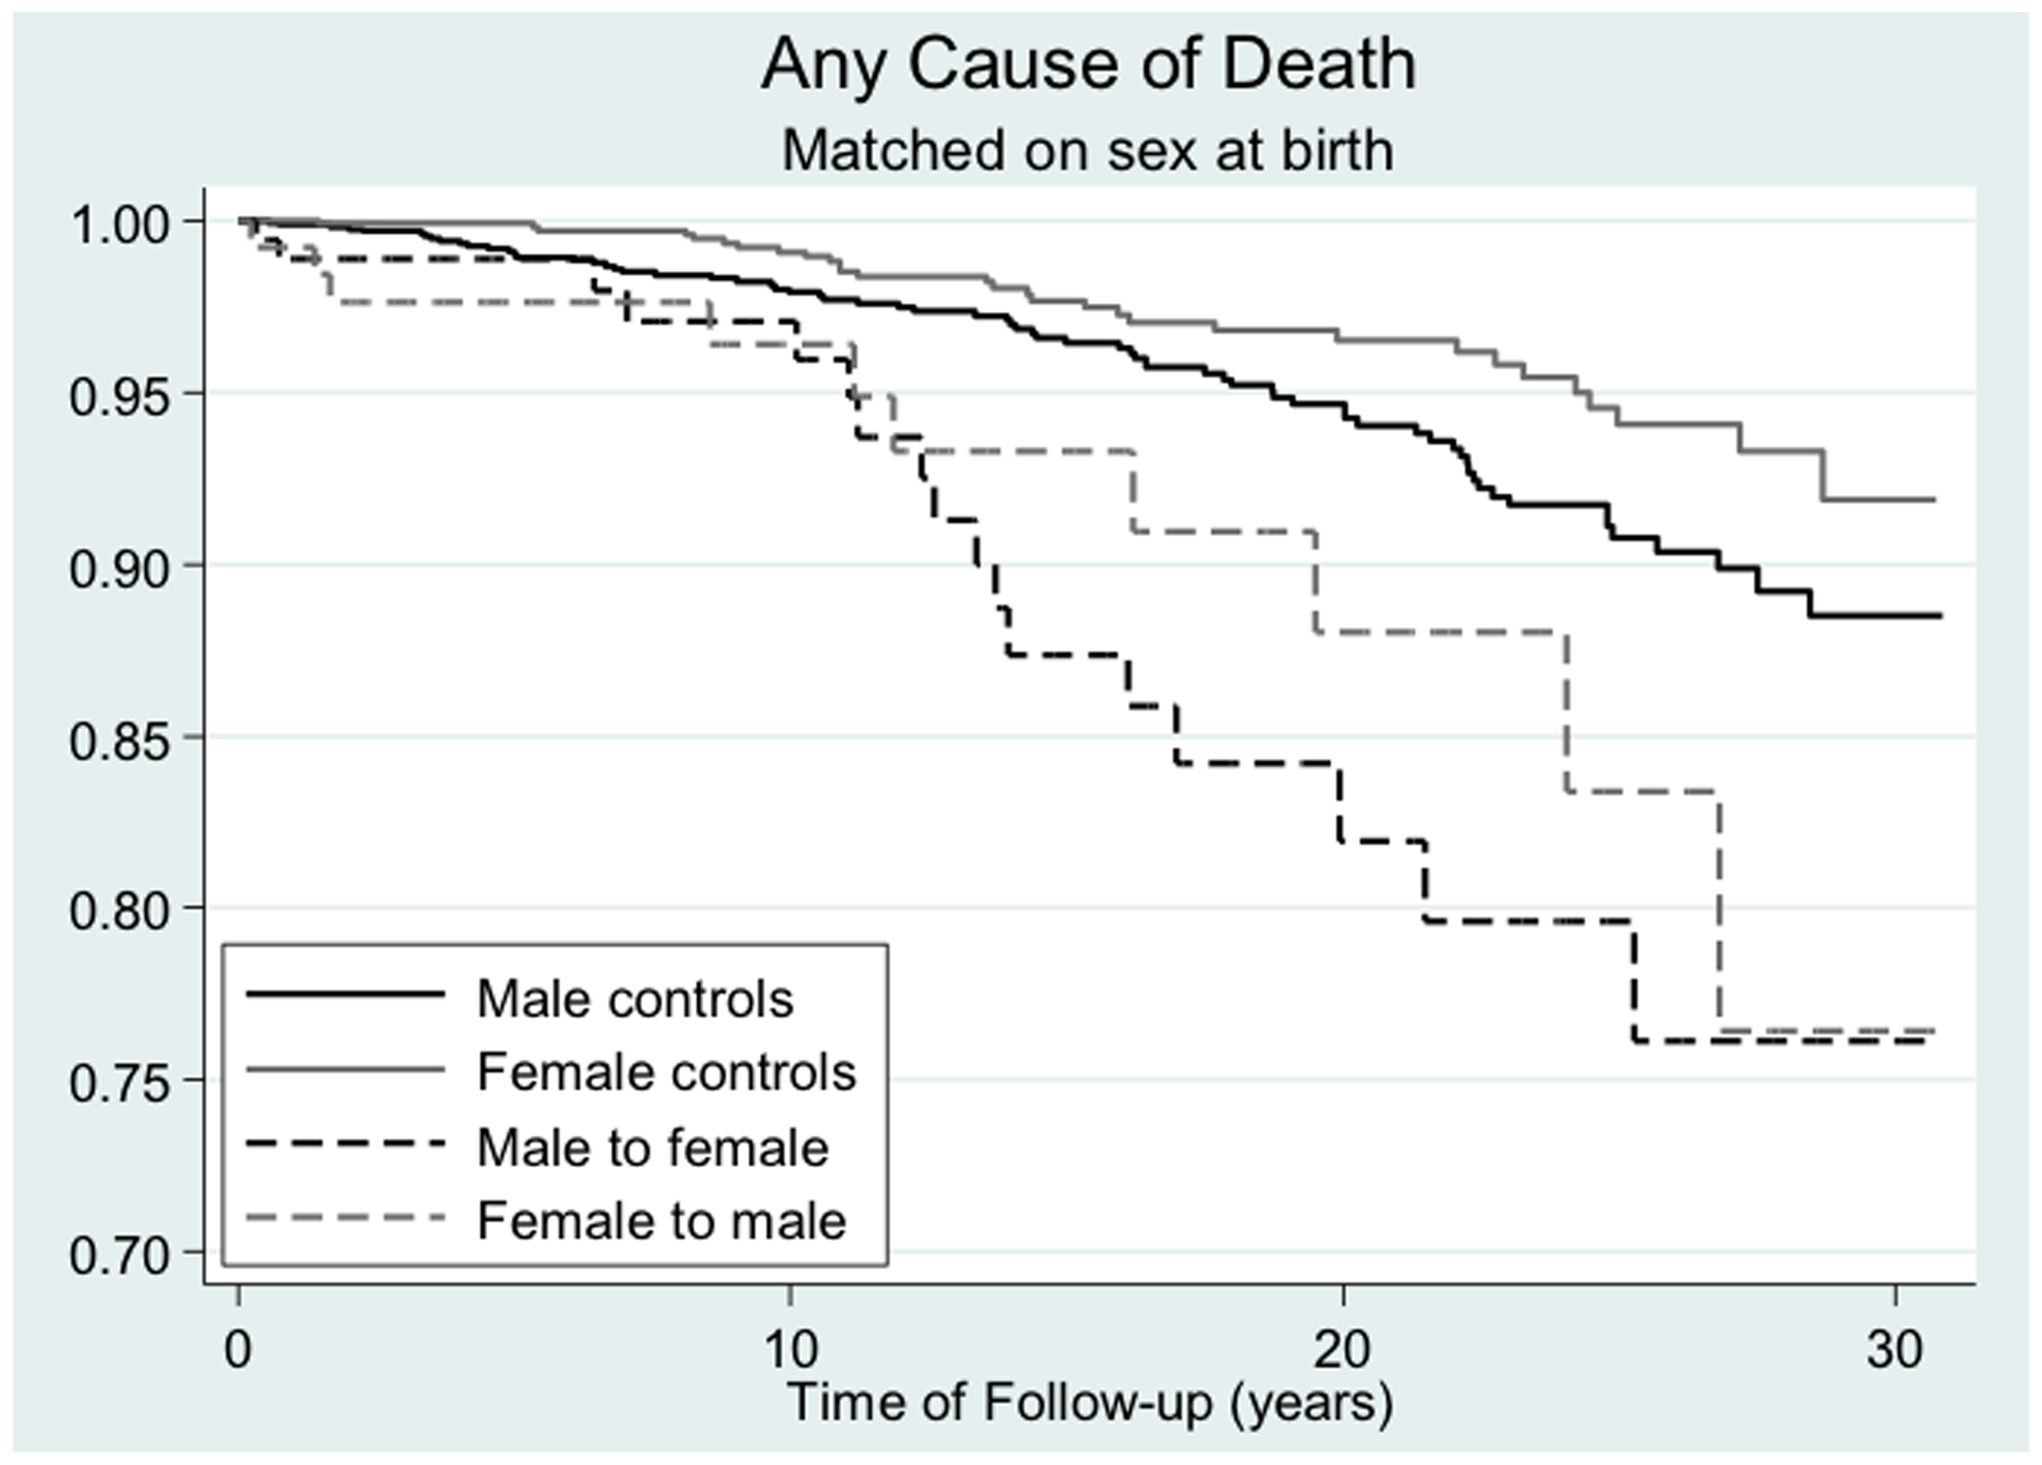

Slide 36
What about Intersex?
Exceptions to the rule, do not invalidate the rule.

Slide 37
A Christian Response
Matthew 10:16: “Behold, I am sending you out as sheep in the midst of wolves, so be wise as serpents and innocent as doves. (ESV)
We must preach the Gospel
Engaging the lost with a debate about LGBTQ worldview will likely cause more angst than fruit
Compassion and understanding for SSA individuals.
Everyone is an image bearer of God and we mustn’t forget that we live in a fallen world.

