Slide 1
Hot Button Issues:
Abortion and Euthanasia and Capital Punishment
Jeff Conner and Nathanael King
7/28/19

Slide 4
Overview
Biblical overview of life/personhood
Defense of life
Abortion
Current debates in abortion
Addressing objections
Natural progression
Euthanasia/Physician assisted suicide
Capital punishment (Nathanael)

Slide 5
“The Bible never mentions abortion.”

Slide 6
“The Bible teaches that unborn children are treated as property, not human life”
Exodus 21:21-25

Slide 7
Exodus 21:22-25
22 "When men strive together, and hurt a woman with child, so that there is a miscarriage, and yet no harm follows, the one who hurt her shall be fined, according as the woman's husband shall lay upon him; and he shall pay as the judges determine. [23] If any harm follows, then you shall give life for life, [24] eye for eye, tooth for tooth, hand for hand, foot for foot, [25] burn for burn, wound for wound, stripe for stripe. (RSV)

Slide 8
Genesis 1:27
[27] So God created man in his own image,
in the image of God he created him;
male and female he created them. (ESV)

Slide 9
Job 31:15
[15] Did not he who made me in the womb make him?
And did not one fashion us in the womb? (ESV)

Slide 10
Psalm 139:13–16
[13] For you formed my inward parts;
you knitted me together in my mother's womb.
[14] I praise you, for I am fearfully and wonderfully made.
Wonderful are your works;
my soul knows it very well.
[15] My frame was not hidden from you,
when I was being made in secret,
intricately woven in the depths of the earth.
[16] Your eyes saw my unformed substance;
in your book were written, every one of them,
the days that were formed for me,
when as yet there was none of them. (ESV)

Slide 11
Psalm 22:10
[10] On you was I cast from my birth,
and from my mother's womb
you have been my God. (ESV)

Slide 12
Jeremiah 1:5
[5] “Before I formed you in the womb I knew you,
and before you were born I consecrated you;
I appointed you a prophet to the nations.” (ESV)

Slide 13
Exodus 21:22–25
[22] “When men strive together and hit a pregnant woman, so that her children come out, but there is no harm, the one who hit her shall surely be fined, as the woman's husband shall impose on him, and he shall pay as the judges determine. [23] But if there is harm, then you shall pay life for life, [24] eye for eye, tooth for tooth, hand for hand, foot for foot, [25] burn for burn, wound for wound, stripe for stripe. (ESV)

Slide 14
The Misuse of Exodus 21:22-25 by Pro-Choice Advocates
John Piper
Implies birth of children, not specifically “miscarriage”
Different words used elsewhere for “unformed substance” or stillborn
Word for “child” used for fully formed children
“further” is not in the original text
“If there was injury” implies to either mother or child
https://www.desiringgod.org/articles/the-misuse-of-exodus-21-22-25-by-pro-choice-advocates

Slide 15
What’s the Christian response?

Slide 16
Christian duty for the defense of life
Unborn are unique human beings created by God
Proverbs 24:11–12:
[11] Rescue those who are being taken away to death;
hold back those who are stumbling to the slaughter.
[12] If you say, “Behold, we did not know this,”
does not he who weighs the heart perceive it?
Does not he who keeps watch over your soul know it, and will he not repay man according to his work? (ESV)
https://www.desiringgod.org/messages/rescuing-unborn-children-required-and-right

Slide 17
Christian response
Compassion
Magnitude of problem
Not studied
Redemption/hope
Ephesians 4:15:
[15] Rather, speaking the truth in love, we are to grow up in every way into him who is the head, into Christ, (ESV)

Slide 19
Current debate
Revolves around personhood
Pro-choice advocates concede that it is life
It’s less valuable life or a life that can be justifiably taken.
A woman’s autonomy and rights currently trump the unborn child’s

Slide 20
Personhood
Even non-Christian philosophers acknowledge some intrinsic value to human life
Where is the soul?
Science can’t fully answer this question
https://cct.biola.edu/neuroscience-the-soul/Research in neurosciences
NDEs- Near death experiences

Slide 21
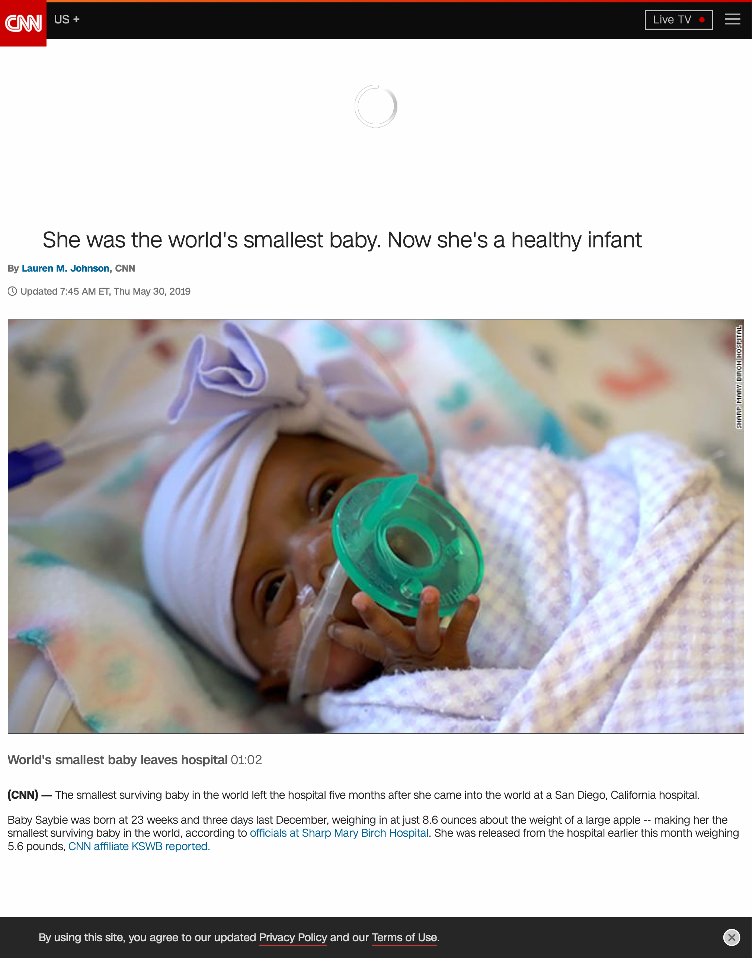

Slide 22
The S.L.E.D. Test
“The Moral Question of Abortion”
Dr. Stephen Schwartz
S- Size
L- Level of Development
E- Environment
D- Degree of Dependency

Slide 23
What about a woman’s right to her own body?

Slide 24
What about in cases of rape and incest?

Slide 25
What about for the health of the mother?

Slide 26
What about vaccines that contain aborted fetuses?
Two cell lines from two aborted fetus in the 1960s
The children were not aborted for the use of their lung tissue
Used only in Hepatitis A vaccine and rubella
Using the cells is not complicit in the act of the abortion
Other implications
https://cmda.org/article/am-i-my-brothers-keeper/

Slide 27
Infanticide
“Post-birth abortion”
Abstract: Abortion is largely accepted even for reasons that do not have anything to do with the fetus’ health. By showing that (1) both fetuses and newborns do not have the same moral status as actual persons, (2) the fact that both are potential persons is morally irrelevant and (3) adoption is not always in the best interest of actual people, the authors argue that what we call ‘after-birth abortion’ (killing a newborn) should be permissible in all the cases where abortion is, including cases where the newborn is not disabled.
Giubilini A, Minerva F After-birth abortion: why should the baby live? Journal of Medical Ethics Published Online First: 23 February 2012. doi: 10.1136/medethics-2011-100411

Slide 28
Q&A

Slide 29
Euthanasia
“the intentional killing by act or omission of a person whose life is felt to be not worth living.”
Voluntary euthanasia- competent person consents
Involuntary euthanasia- the patient lacks the competence to make an end-of-life decision.
Assisted suicide- where someone helps another person end their own life.
Physician assisted suicide- the doctor indirectly or directly performs a lethal act.

Slide 30
What is not Euthanasia:
Stopping medically futile treatment
Giving treatments aimed at relieving pain and other symptoms, even when the treatment may very occasionally carry some risk of shortening life
When a mentally competent person chooses to refuse treatment.

Slide 31
American Medical Association
Has not supported physician-assisted suicide
Current debate: Physician-assisted suicide vs “aid-in-dying”
“Neutral Engagement”

Slide 32
What Hippocrates Knew
Text
c. 450- c. 380 B.C.
One of the first codes of professional ethics
Trivia: What is the only specialty mentioned in the original Hippocratic Oath?
Significant changes over time

Slide 34
“It’s not a matter of wanting to end my life, it’s a matter of not wanting my life to be this.”
Debbie Purdy
“Right-to-die” Activist

Slide 36
Christian Views on Euthanasia
Human Life bears God’s image
We are part of community joined to each other- we are not autonomous
Great risk that people would feel pressured into accessing suicide or euthanasia

Slide 37
Issues in the debate, John Stott
Value
Fear
Of uncontrollable and unbearable pain
Of indignity
Of dependence
Autonomy

Slide 38
Q&A

Slide 39
Hot Button Issues
Capital Punishment

Slide 40
Overview
Rehabilitationism: No capital punishment for any crimes.
Reconstructionism: Capital punishment for all major crimes.
Retributionism: Capital punishment for capital crimes.

Slide 41
Key Questions
What is the purpose of punishment?
Retribution or rehabilitation?
What is the role of the Old Testament Law?
Binding or informative?
How do we uphold the value of human life?

Slide 42
Psalm 8:5–7
[5] Yet you have made him a little lower than the heavenly beings
and crowned him with glory and honor.
[6] You have given him dominion over the works of your hands;
you have put all things under his feet,
[7] all sheep and oxen,
and also the beasts of the field, (ESV)

Slide 43
Psalm 127:3–5
[3] Behold, children are a heritage from the LORD,
the fruit of the womb a reward.
[4] Like arrows in the hand of a warrior
are the children of one's youth.
[5] Blessed is the man
who fills his quiver with them!
He shall not be put to shame
when he speaks with his enemies in the gate. (ESV)

Slide 44
Isaiah 49:15
[15] “Can a woman forget her nursing child,
that she should have no compassion on the son of her womb?
Even these may forget,
yet I will not forget you. (ESV)

Slide 45
Hot Button Issues
Capital Punishment

Slide 46
Overview
Rehabilitationism: No capital punishment for any crimes.
Reconstructionism: Capital punishment for all major crimes.
Retributionism: Capital punishment for capital crimes.

Slide 47
Key Questions
What is the purpose of punishment?
Retribution or rehabilitation?
What is the role of the Old Testament Law?
Binding or informative?
How do we uphold the value of human life?

