Slide 1
Hot Button Issues
Science and the Bible

Slide 2
Outline
Christian Worldview and Science
Major Views of Creation
Biblical considerations about Creation
Scientific considerations about Creation

Slide 3
Christian Worldview and Science
There is superficial concord but deep conflict between science and atheism.
There is superficial conflict but deep concord between science and Christianity.

Slide 4
Christian Worldview and Science
There is superficial concord but deep conflict between science and atheism.
Atheism cannot account for human freewill and rational deliberation.
Atheism cannot account for our ability to trust our own senses and mental states.
Atheism cannot account for philosophical assumptions that undergird science.

Slide 5
Christian Worldview and Science
Philosophical assumptions that undergird science:
the existence of a theory independent, external world
the orderly nature of the external world
the knowability of the external world
the existence of truth
the laws of logic
the reliability of our cognitive and sensory faculties to serve as truth gatherers
the adequacy of language to describe the world
the existence of values used in science (for example, “test theories fairly and report results honestly”)
the uniformity of nature and induction
the existence of numbers and mathematical truths
the existence of true and rationally justified beliefs outside of science
the objective basis for the value of human life.

Slide 6
Christian Worldview and Science
There is superficial conflict but deep concord between science and Christianity.
Superficial conflicts arise when we treat the Bible as if it were a science book.
Superficial conflicts arise when we don’t understand the limits of science.
Christianity provides a worldview in which the assumptions of science are best justified.
A Christian worldview makes sense of the beginning of the universe and the fine-tuning of the universe for life.

Slide 7
Christian Worldview and Science
"Consider the enormity of the problem. Science has proved that the universe exploded into being at a certain moment. It asks: What cause produced this effect? Who or what put the matter or energy into the universe? And science cannot answer these questions, because, according to the astronomers, in the first moments of its existence the Universe was compressed to an extraordinary degree, and consumed by the heat of a fire beyond human imagination. The shock of that instant must have destroyed every particle of evidence that could have yielded a clue to the cause of the great explosion."
"For the scientist who has lived by his faith in the power of reason, the story ends like a bad dream. He has scaled the mountain of ignorance; he is about to conquer the highest peak; as he pulls himself over the final rock, he is greeted by a band of theologians who have been sitting there for centuries.“
--Robert Jastrow, NASA Astronomer

Slide 8
Three vs. Four Views of Creation
Jeff Conner

Slide 9
The Views
Recent (Young Earth) Creation
Progressive (Old Earth) Creation
Theistic Evolution
Intelligent Design

Slide 10
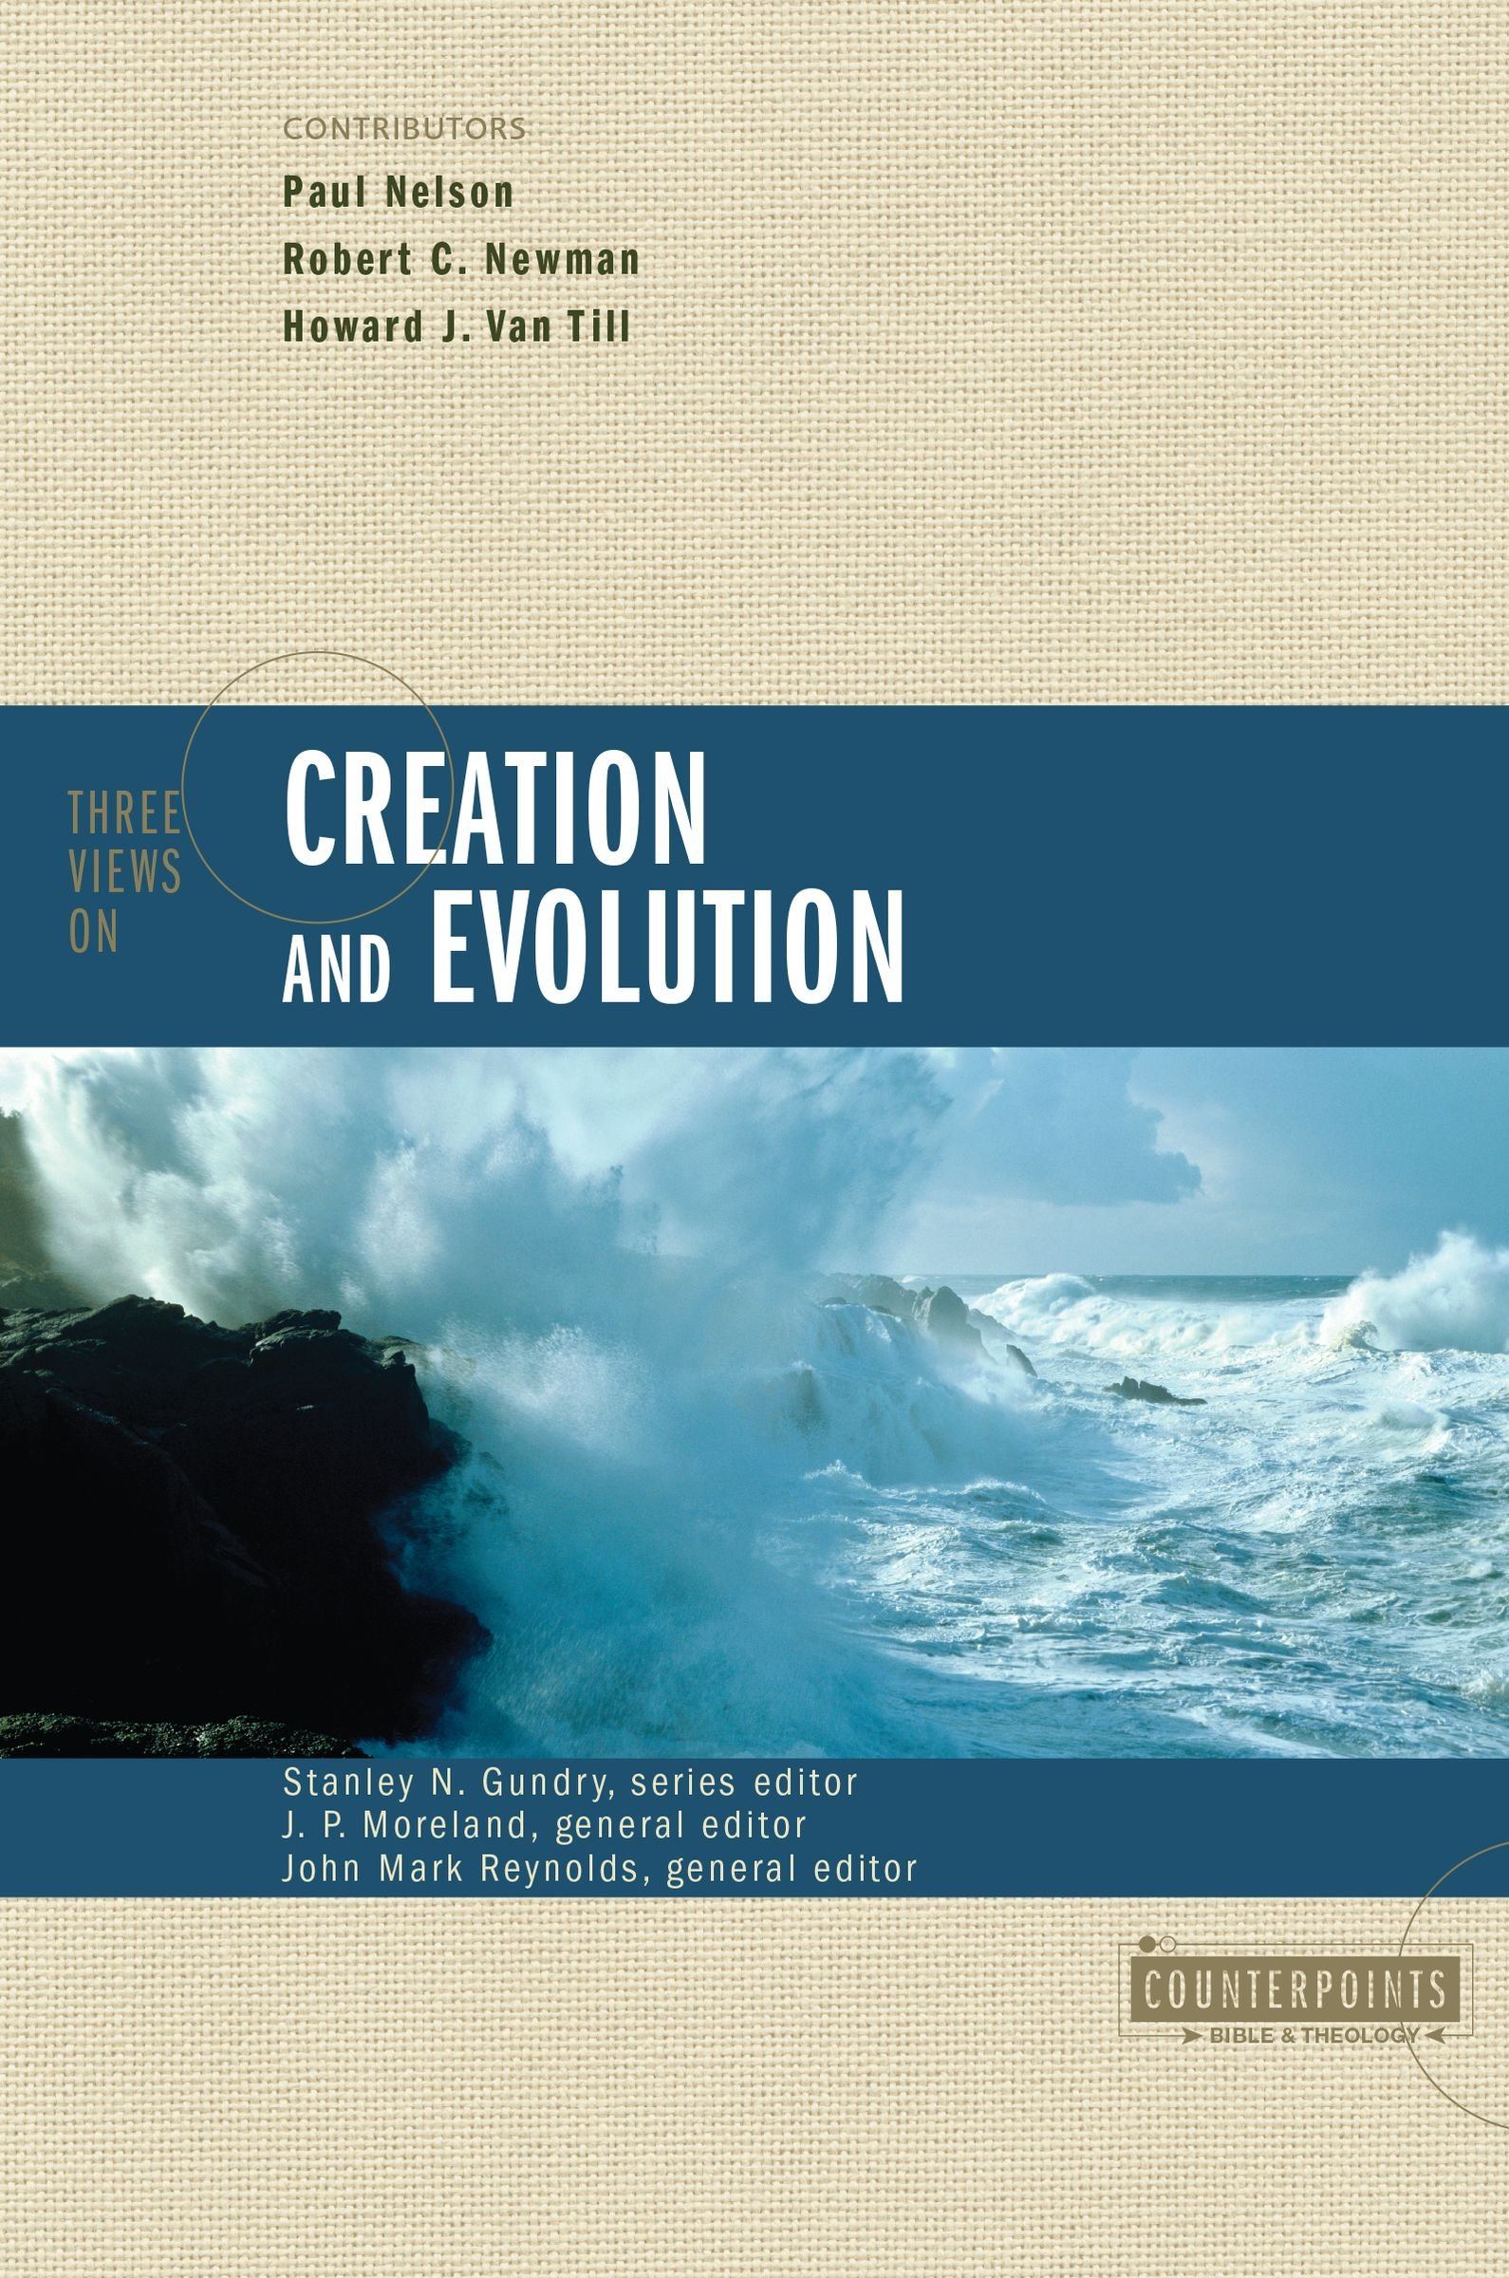

Slide 11
Recent (Young Earth) Creationism
Creation Research Society
https://creationresearch.org
Institute for Creation Research
icr.org
Logos Research Associates
https://www.logosresearchassociates.org
Literal 6 day creation
Very high regard for Scripture
Perfect creation- death introduced by the Fall

Slide 12
Progressive (Old Earth) Creation
Universe and Earth were created over time
Life created later in epochs
Rejects common ancestor explanations of life
Allows for scientific evidence of older earth
Reasons to Believe
https://www.reasons.org/
Hugh Ross

Slide 13
Theistic Evolution
Aka, “Evolutionary Creation”, “Biologos”
Embraces mainstream scientific consensus of evolution
God used Evolution to bring about the origins of life
Methodological Naturalism
Excludes transcendent agency
Biologos
https://biologos.org

Slide 14
 | Recent (YoungEarth) | Progressive (Old Earth) | Theistic Evolution
Open philosophy of science | yes | yes | no
Biological Discontinuity and design | yes | yes | no
Curse affecting natural economy | yes | no | no
Global flood | yes | no | no
John Mark Reynolds. Three Views on Creation and Evolution (Counterpoints: Bible and Theology) . Zondervan. Kindle Edition.

Slide 15
Intelligent Design
Does not necessarily exclude the other three views
Theistic evolutionists reject this
Methodological Naturalism rejected
INFORMATION is not random and indicates a designer
Discovery Institute
https://www.discovery.org

Slide 16
Biblical Considerations about Creation

Slide 17
Biblical Considerations about Creation
Evidence for the Historical Person of Adam:
The specificity of the Genesis 1-3 account
Inclusion of Adam in Genealogies: Gen 5:1, Luke 3:38
See Genealogy and History in the Biblical World by Robert R. Wilson.
NT Data:
1 Tim. 2:12-14 ESV 12 I do not permit a woman to teach or to exercise authority over a man; rather, she is to remain quiet. 13 For Adam was formed first, then Eve; 14 and Adam was not deceived, but the woman was deceived and became a transgressor.
Matt. 19:4-6 ESV 4 He answered, "Have you not read that he who created them from the beginning made them male and female, 5 and said, 'Therefore a man shall leave his father and his mother and hold fast to his wife, and the two shall become one flesh'? 6 So they are no longer two but one flesh. What therefore God has joined together, let not man separate."

Slide 18
Biblical Considerations about Creation
Meaning of the Hebrew word yom (“day”)
The poetic nature of Genesis 1:1-2:3
The events of the 6th day
The gap theory
God’s existence compared to the longevity of the mountains
The analogy with God’s work week
The nature of the 7th day

Slide 19
Critiques of Modern Evolutionary Theory
Randomness creating order
Irreducible complexity or specified complexity
No real observable results
Second law of thermodynamics

Slide 20
Scientific Critique of Intelligent Design
Viewed as “Creationism in Disguise”
Only a “philosophical movement”
Biggest critics of modern evolutionary theory
Stephen C. Meyer, Michael Behe, Bill Demski

Slide 21
Scientific Critique of Theistic Evolution
Methodological Naturalism
Science has not proven that only science can explain things
Rejects philosophical approaches
Leprechaun and water boiling

Slide 22
Scientific Critique of OE Creation
? None
Invokes “God of the Gaps”

Slide 23
Scientific Support and Critique of Recent (YE) Creation
The Universe is old
Earth is old
Life is old
Doesn’t follow paradigm of modern scientific discoveries regarding age of universe
Viewed as extreme by some
Mount Saint Helen’s
Steve Austin
https://www.logosresearchassociates.org

