Slide 1
Hot Button Issues
Christianity and politics

Slide 2
Outline
Introduction
Five wrong views of Christians and government
Principles for how Christians should view government
Is America a Christian nation?

Slide 3
Five Wrong Views of Christians and Government
Government should compel religion.

Slide 4
Five Wrong Views of Christians and Government
  Matt. 22:17-21 ESV 17 Tell us, then, what you think. Is it lawful to pay taxes to Caesar, or not?" 18 But Jesus, aware of their malice, said, "Why put me to the test, you hypocrites? 19 Show me the coin for the tax." And they brought him a denarius. 20 And Jesus said to them, "Whose likeness and inscription is this?" 21 They said, "Caesar's." Then he said to them, "Therefore render to Caesar the things that are Caesar's, and to God the things that are God's."

Slide 5
Five Wrong Views of Christians and Government
  Lk. 9:52-55 ESV 52 And he sent messengers ahead of him, who went and entered a village of the Samaritans, to make preparations for him. 53 But the people did not receive him, because his face was set toward Jerusalem. 54 And when his disciples James and John saw it, they said, "Lord, do you want us to tell fire to come down from heaven and consume them?" 55 But he turned and rebuked them.

Slide 6
Five Wrong Views of Christians and Government
  Acts 28:23-24 ESV 23 When they had appointed a day for him, they came to him at his lodging in greater numbers. From morning till evening he expounded to them, testifying to the kingdom of God and trying to convince them about Jesus both from the Law of Moses and from the Prophets. 24 And some were convinced by what he said, but others disbelieved.

Slide 7
Five Wrong Views of Christians and Government
  Jn. 18:36 ESV 36 Jesus answered, "My kingdom is not of this world. If my kingdom were of this world, my servants would have been fighting, that I might not be delivered over to the Jews. But my kingdom is not from the world.“
  1 Jn. 3:8 ESV 8 Whoever makes a practice of sinning is of the devil, for the devil has been sinning from the beginning. The reason the Son of God appeared was to destroy the works of the devil.

Slide 8
Five Wrong Views of Christians and Government
Government should compel religion.
Government should exclude religion.

Slide 9

Five Wrong Views of Christians and Government
Government should compel religion.
Government should exclude religion.

Slide 10
Five Wrong Views of Christians and Government
Government should compel religion.
Government should exclude religion.

Slide 11
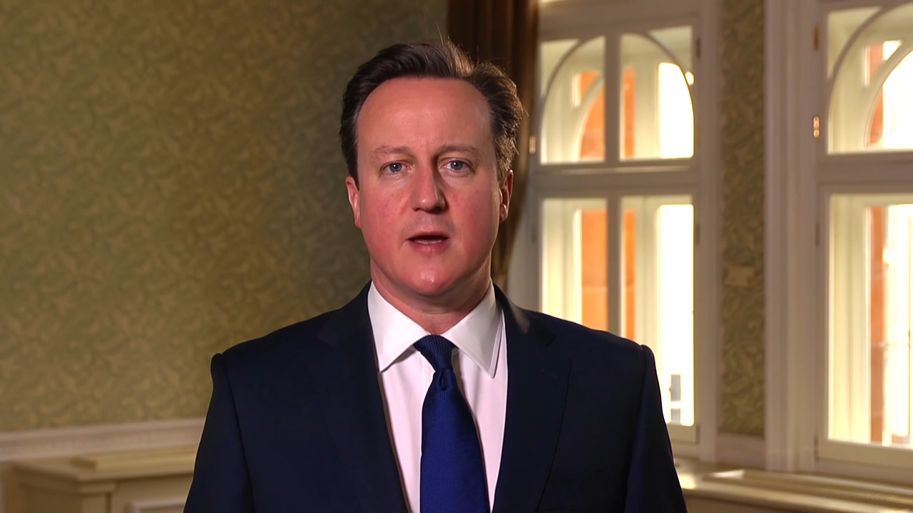

Slide 12
Five Wrong Views of Christians and Government
  1 Cor. 10:31 ESV 31 So, whether you eat or drink, or whatever you do, do all to the glory of God.
  Col. 3:17 ESV 17 And whatever you do, in word or deed, do everything in the name of the Lord Jesus, giving thanks to God the Father through him.

Slide 13
Five Wrong Views of Christians and Government
Government should compel religion.
Government should exclude religion.
All government is evil and demonic.

Slide 14
Five Wrong Views of Christians and Government
  Lk. 4:6-8 ESV 6 and said to him, "To you I will give all this authority and their glory, for it has been delivered to me, and I give it to whom I will. 7 If you, then, will worship me, it will all be yours." 8 And Jesus answered him, "It is written, "'You shall worship the Lord your God, and him only shall you serve.’”
  Jn. 8:44 ESV He was a murderer from the beginning, and does not stand in the truth, because there is no truth in him. When he lies, he speaks out of his own character, for he is a liar and the father of lies.

Slide 15
Five Wrong Views of Christians and Government
Government should compel religion.
Government should exclude religion.
All government is evil and demonic.
Do evangelism, not politics.

Slide 16
Five Wrong Views of Christians and Government
  1 Tim. 2:1-4 ESV First of all, then, I urge that supplications, prayers, intercessions, and thanksgivings be made for all people, 2 for kings and all who are in high positions, that we may lead a peaceful and quiet life, godly and dignified in every way. 3 This is good, and it is pleasing in the sight of God our Savior, 4 who desires all people to be saved and to come to the knowledge of the truth.

Slide 17
Five Wrong Views of Christians and Government
  1 Tim. 2:1-4 ESV First of all, then, I urge that supplications, prayers, intercessions, and thanksgivings be made for all people, 2 for kings and all who are in high positions, that we may lead a peaceful and quiet life, godly and dignified in every way. 3 This is good, and it is pleasing in the sight of God our Savior, 4 who desires all people to be saved and to come to the knowledge of the truth.

Slide 18
Five Wrong Views of Christians and Government
  Matt. 22:39 ESV 39 And a second is like it: You shall love your neighbor as yourself.
  Gal. 6:10 ESV 10 So then, as we have opportunity, let us do good to everyone, and especially to those who are of the household of faith.
  Eph. 2:10 ESV 10 For we are his workmanship, created in Christ Jesus for good works, which God prepared beforehand, that we should walk in them.
  Gen. 1:28 ESV 28 And God blessed them. And God said to them, "Be fruitful and multiply and fill the earth and subdue it, and have dominion over the fish of the sea and over the birds of the heavens and over every living thing that moves on the earth."

Slide 19
Five Wrong Views of Christians and Government
  Rom. 13:3-4 ESV 3 For rulers are not a terror to good conduct, but to bad. Would you have no fear of the one who is in authority? Then do what is good, and you will receive his approval, 4 for he is God's servant for your good. But if you do wrong, be afraid, for he does not bear the sword in vain. For he is the servant of God, an avenger who carries out God's wrath on the wrongdoer.

Slide 20
Five Wrong Views of Christians and Government
Government should compel religion.
Government should exclude religion.
All government is evil and demonic.
Do evangelism, not politics.
Do politics, not evangelism.

Slide 21
Christians should seek significant influence in civil government.
Dan. 4:27 ESV 27 Therefore, O king, let my counsel be acceptable to you: break off your sins by practicing righteousness, and your iniquities by showing mercy to the oppressed, that there may perhaps be a lengthening of your prosperity."

Slide 22
Christians should seek significant influence in civil government.
Jer. 29:7 ESV 7 But seek the welfare of the city where I have sent you into exile, and pray to the LORD on its behalf, for in its welfare you will find your welfare.

Slide 23
Christians should seek significant influence in civil government.
Matt. 14:3-4 ESV 3 For Herod had seized John and bound him and put him in prison for the sake of Herodias, his brother Philip's wife, 4 because John had been saying to him, "It is not lawful for you to have her."
Lk. 3:18-20 ESV 18 So with many other exhortations he preached good news to the people. 19 But Herod the tetrarch, who had been reproved by him for Herodias, his brother's wife, and for all the evil things that Herod had done, 20 added this to them all, that he locked up John in prison.

Slide 24
Christians should seek significant influence in civil government.
Acts 24:24-25 ESV 24 After some days Felix came with his wife Drusilla, who was Jewish, and he sent for Paul and heard him speak about faith in Christ Jesus. 25 And as he reasoned about righteousness and self-control and the coming judgment, Felix was alarmed and said, "Go away for the present. When I get an opportunity I will summon you."

Slide 25
Government is established by God for our good to execute justice and defend the weak, and so we should be submit to and respect government authority.
Jdg. 17:6 ESV 6 In those days there was no king in Israel. Everyone did what was right in his own eyes.

Slide 26
Rom. 13:1-7
Let every person be subject to the governing authorities. For there is no authority except from God, and those that exist have been instituted by God. ² Therefore whoever resists the authorities resists what God has appointed, and those who resist will incur judgment. ³ For rulers are not a terror to good conduct, but to bad. Would you have no fear of the one who is in authority? Then do what is good, and you will receive his approval, ⁴ for he is God's servant for your good. But if you do wrong, be afraid, for he does not bear the sword in vain. For he is the servant of God, an avenger who carries out God's wrath on the wrongdoer. ⁵ Therefore one must be in subjection, not only to avoid God's wrath but also for the sake of conscience. ⁶ For because of this you also pay taxes, for the authorities are ministers of God, attending to this very thing. ⁷ Pay to all what is owed to them: taxes to whom taxes are owed, revenue to whom revenue is owed, respect to whom respect is owed, honor to whom honor is owed.

Slide 27
Government is established by God for our good to execute justice and defend the weak, and so we should be submit to and respect government authority.
1 Pet. 2:13-14 ESV 13 Be subject for the Lord's sake to every human institution, whether it be to the emperor as supreme, 14 or to governors as sent by him to punish those who do evil and to praise those who do good.

Slide 28
Character is the most important attribute of leaders, political or otherwise.
Prov. 14:34 ESV 34 Righteousness exalts a nation, but sin is a reproach to any people.
Prov. 16:5 ESV 5 Everyone who is arrogant in heart is an abomination to the LORD; be assured, he will not go unpunished.
Prov. 16:12 ESV 12 It is an abomination to kings to do evil, for the throne is established by righteousness.

Slide 29
Character is the most important attribute of leaders, political or otherwise.
Prov. 31:3-5 ESV 3 Do not give your strength to women, your ways to those who destroy kings. 4 It is not for kings, O Lemuel, it is not for kings to drink wine, or for rulers to take strong drink, 5 lest they drink and forget what has been decreed and pervert the rights of all the afflicted.
Prov. 20:28 ESV 28 Steadfast love and faithfulness preserve the king, and by steadfast love his throne is upheld.

Slide 30
Our ultimate hope is not in this world, but in God’s future kingdom.
Phil. 3:20-21 ESV 20 But our citizenship is in heaven, and from it we await a Savior, the Lord Jesus Christ, 21 who will transform our lowly body to be like his glorious body, by the power that enables him even to subject all things to himself.

Slide 31
Is America a Christian Nation?
Does God have a covenant relationship with the United States of America?
Has God blessed our country?

Slide 32
Is America a Christian Nation?
Is Christianity (of various sorts) the largest religion in the United States?
Are a majority of people in the United States Bible-believing, evangelical, born-again Christians?
Is belief in Christian values the dominant perspective promoted by the United States government, the media, and universities in the United States today?

Slide 33
Is America a Christian Nation?
Does the United States government promote Christianity as the national religion?
Does a person have to profess Christian faith in order to become a US citizen or to have equal rights under the law in the United States?
Was there a Supreme Court decision at one time that affirmed that the United States is a Christian nation?

Slide 34
Is America a Christian Nation?
Was there a Supreme Court decision at one time that affirmed that the United States is a Christian nation?
Does the United States government promote Christianity as the national religion?
Does a person have to profess Christian faith in order to become a US citizen or to have equal rights under the law in the United States?

Slide 35
Is America a Christian Nation?
Is Christian teaching the primary religious system that influenced the founding of the United States?
Were the majority of the Founding Fathers of the United States Christians who generally believed in the truth of the Bible?
Did Christian beliefs provide the intellectual background that led to many of the cultural values still held by Americans today?

Slide 36
Is America a Christian Nation?
Isa. 33:22 ESV 22 For the LORD is our judge; the LORD is our lawgiver; the LORD is our king; he will save us.

Slide 37
Is America a Christian Nation?
Is Christian teaching the primary religious system that influenced the founding of the United States?
Were the majority of the Founding Fathers of the United States Christians who generally believed in the truth of the Bible?
Did Christian beliefs provide the intellectual background that led to many of the cultural values still held by Americans today?

Slide 38
Is America a Christian Nation?
I sought for the greatness and genius of America in her commodious harbors and her ample rivers—and it was not there. I sought in the fertile fields and boundless forest—in her rich mines and vast world commerce—and it was not there. I sought for the greatness and genius of America in her democratic Congress and her matchless Constitution—it was not there. Not until I went into the churches of America and heard her pulpits flame with righteousness did I understand the secret of her genius and power. America is great because America is good—and if America ever ceases to be good, America will cease to be great. (Alexis de Toqueville, Democracy in America).

